Slide 1
Chapter 5
Innovative EC Systems: From E-Government to
E-Learning, Collaborative Commerce, and C2C Commerce

Slide 2
Learning Objectives
Describe various e-government initiatives.
Describe e-government activities and implementation issues including e-government 2.0 and m-government.
Describe e-learning, virtual universities, and e-training.
Describe e-books and their readers.

Slide 3
Learning Objectives
Describe knowledge management and dissemination as an e-business.
Describe and discuss online advisory systems.
Describe collaborative e-commerce.
Describe collaboration 2.0.
Describe C2C activities in e-commerce.

Slide 4
E-Government: An Overview
e-government
E-commerce model in which a government entity buys or provides goods, services, or information to businesses or individual citizens
government-to-citizens (G2C)
E-government category that includes all the interactions between a government and its citizens
Electronic Voting
Electronic Benefits Transfer

Slide 5
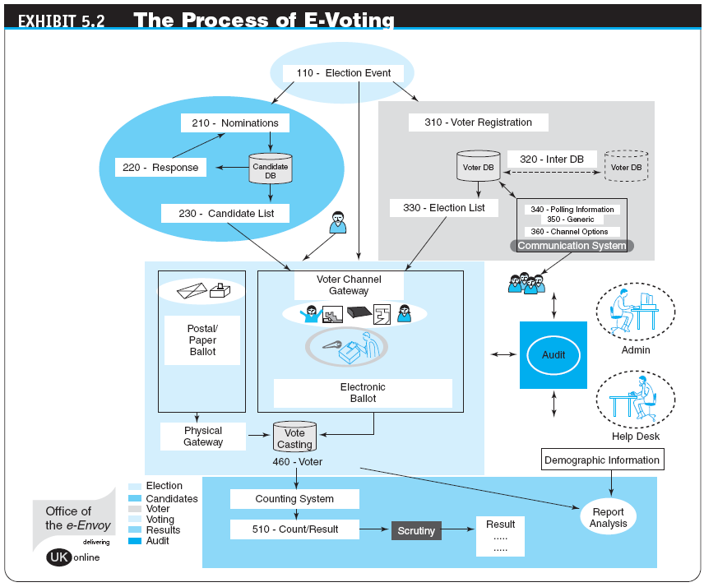

Slide 6
E-Government: An Overview
government-to-business (G2B)
E-government category that includes interactions between governments and businesses (government selling to businesses and providing them with services and businesses selling products and services to the government)
Government E-Procurement
Group Purchasing

Slide 7
E-Government: An Overview
government-to-government (G2G)
E-government category that includes activities within government units and those between governments
government-to-employees (G2E)
E-government category that includes activities and services between government units and their employees
Internal Efficiency and Effectiveness (IEE)

Slide 8
E-Government: An Overview
IMPLEMENTING E-GOVERNMENT
THE TRANSFORMATION TO E-GOVERNMENT
Government 2.0
How government makes use of Web 2.0 technologies to interact with citizens and provide government services
The Promise of Government 2.0

Slide 9
E-Government: An Overview
mobile government (m-government)
The wireless implementation of e-government mostly to citizens but also to businesses
The Benefits of M-Government
Some Implementation Issues
Applications

Slide 10
E-Learning, E-Training, and E-Books
e-learning
The online delivery of information for purposes of education, training, or knowledge management
BENEFITS AND DRAWBACKS OF E-LEARNING

Slide 11
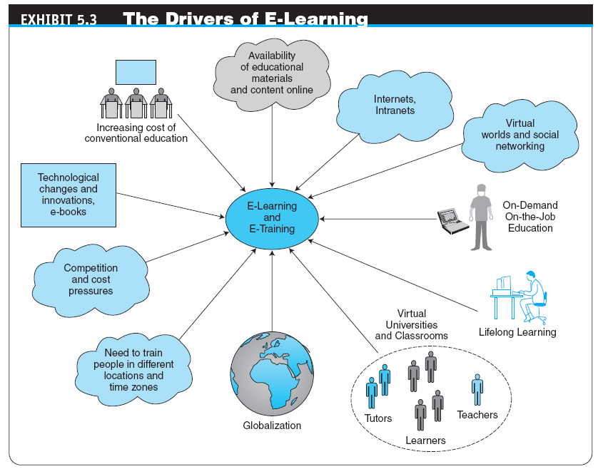

Slide 12
E-Learning, E-Training, and E-Books
distance learning
Formal education that takes place off campus, usually, but not always, through online resources
virtual university
An online university from which students take classes from home or other offsite locations, usually via the Internet
Innovations in E-Learning

Slide 13
E-Learning, E-Training, and E-Books
ONLINE CORPORATE TRAINING
Examples of Corporate Training
social learning
Learning, training, and knowledge sharing in social networks and by using social software tools for learning

Slide 14
E-Learning, E-Training, and E-Books
LEARNING IN VIRTUAL WORLDS AND SECOND LIFE
VISUAL INTERACTIVE SIMULATION
learning on-demand
Learning provided to an employee while the work is being done (in terms of troubleshooting or performance support)
In a learning on-demand environment, courses, references, help files, documents, Webcasts, audios, videos, books, and presentations are all made available when and where a worker needs them.

Slide 15
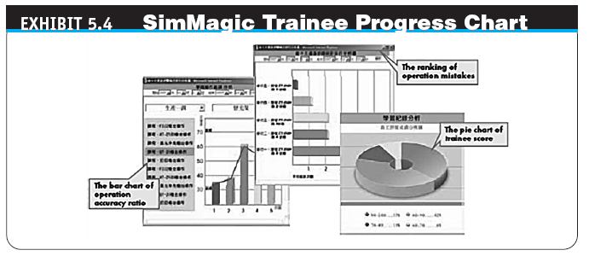

Slide 16
E-Learning, E-Training, and E-Books
learning management system (LMS)
Software applications for the administration, documentation, tracking, and reporting of training programs, classroom and online events, e-learning programs, and training content
IMPLEMENTING E-LEARNING AND E-TRAINING
Some Representative E-Learning Tools

Slide 17
E-Learning, E-Training, and E-Books
electronic book (e-book)
A book in digital form that can be read on a computer screen or on a special device
Devices for Reading E-Books
Advantages and Limitations of E-Books

Slide 18
Knowledge Management, Advisory Systems, and Electronic Commerce
knowledge management (KM)
The process of capturing or creating knowledge, storing it, updating it constantly, disseminating it, and using it whenever necessary
KM TYPES AND ACTIVITIES
Create knowledge
Capture knowledge
Refine knowledge
Store knowledge
Manage knowledge
Disseminate knowledge

Slide 19
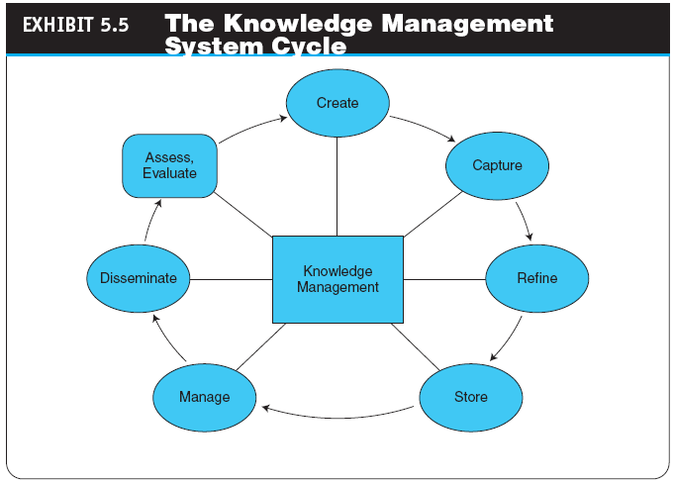

Slide 20
Knowledge Management, Advisory Systems, and Electronic Commerce
KNOWLEDGE SHARING
Software Tools for Knowledge Sharing
HOW IS KNOWLEDGE MANAGEMENT RELATED TO E-COMMERCE?
KM AND SOCIAL NETWORKS
Knowledge creation
Knowledge sharing
DEPLOYING KM TECHNOLOGIES

Slide 21
Knowledge Management, Advisory Systems, and Electronic Commerce
ONLINE ADVICE AND CONSULTING
Medical advice
Management consulting
Legal advice
Gurus
Financial advice
Social networks
Other advisory services

Slide 22
Knowledge Management, Advisory Systems, and Electronic Commerce
automated question/answer (QA) system
A system that locates, extracts, and provides specific answers to user questions expressed in natural language
Live Chat with Experts

Slide 23
Knowledge Management, Advisory Systems, and Electronic Commerce
expert location systems (ELS)
Interactive computerized systems that help employees find and connect with colleagues who have expertise required for specific problems—whether they are across the country or across the room—in order to solve specific, critical business problems in seconds
Seeking Expertise in Social Networks

Slide 24
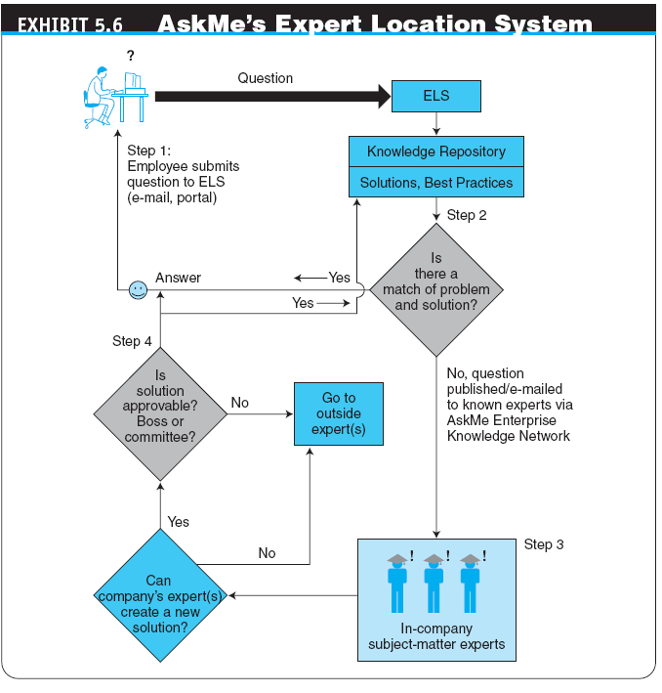

Slide 25
Collaborative Commerce
collaborative commerce (c-commerce)
The use of digital technologies that enable companies to collaboratively plan, design, develop, manage, and research products, services, and innovative EC applications
collaboration hub (c-hub)
The central point of control for an e-market; a single c-hub, representing one e-market owner, can host multiple collaboration spaces (c-spaces) in which trading partners use c-enablers to exchange data with the c-hub

Slide 26
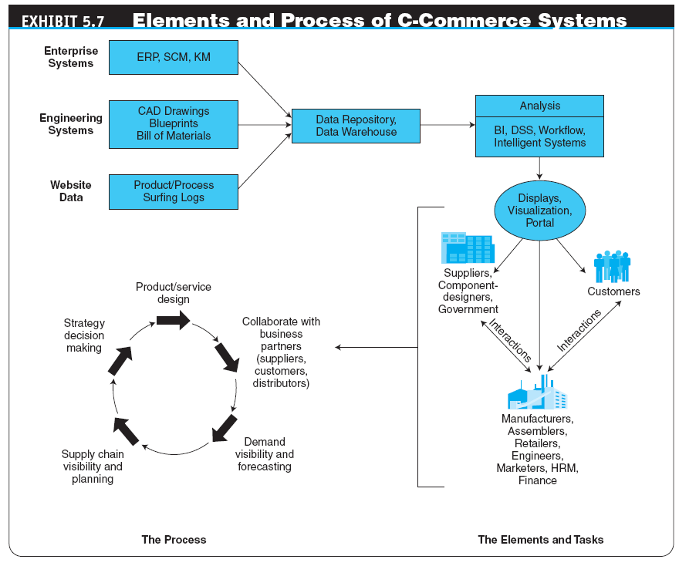

Slide 27
Collaborative Commerce
REPRESENTATIVE EXAMPLES OF COLLABORATIVE COMMERCE
vendor-managed inventory (VMI)
A system in which retailers make their suppliers fully responsible for determining when to order and possibly how much to order
Retailer-Supplier Collaboration
Example: Target

Slide 28
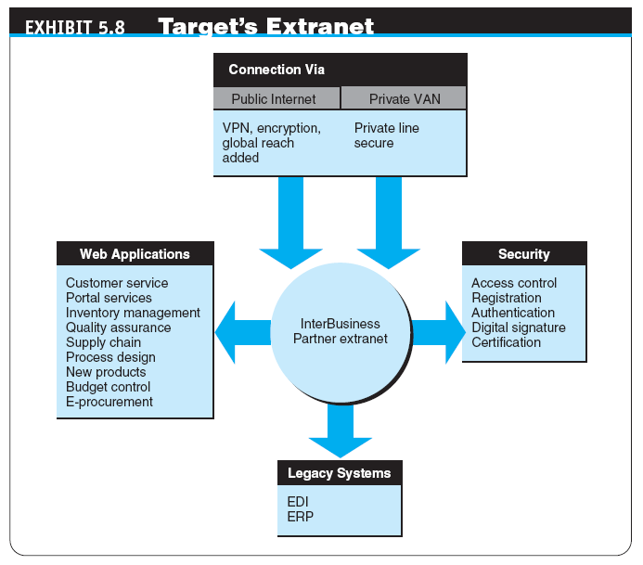

Slide 29
Collaborative Commerce
Reducing Transportation and Inventory Costs
Reduction of Design Cycle Time
Reduction of Product Development Time
Elimination of Channel Conflict: Collaboration with Dealers and Retailers
IMPLEMENTING C-COMMERCE
BARRIERS TO C-COMMERCE
Overcoming Barriers to Collaboration

Slide 30
Consumer-to-Consumer Electronic Commerce
consumer-to-consumer (C2C) EC
E-commerce model in which consumers sell directly to other consumers
E-COMMERCE: C2C APPLICATIONS
C2C Auctions
Classified Ads
Personal Services
File-Sharing Utilities: Napster and Others
C2C Activities in Social Networks and Trading Virtual Properties

Slide 31
Managerial Issues
What are the e-government opportunities?
How do we design the most cost-efficient government e-procurement system?
How do we design the portfolio of e-learning knowledge sources?
How do we incorporate social networking–based learning and services in our organization?
What will the impact be of the e-book platform?

Slide 32
Managerial Issues
How do we connect our expert location system and social networking initiatives?
How difficult is it to introduce e-collaboration?
Can we capitalize on C2C EC?
How much can be shared with business partners?
Who benefits from vendor-managed inventory?

Slide 33
Summary
E-government activities
Implementing e-government to citizens, businesses, and its own operations
E-learning and training
E-books and their readers
Knowledge management and dissemination as an e-business

Slide 34
Summary
Online advisory systems
C-commerce
Collaboration 2.0
C2C activities

Slide 35
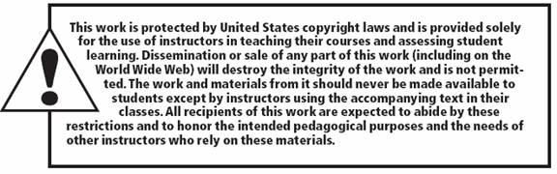
All rights reserved. No part of this publication may be reproduced, stored in a retrieval system, or transmitted, in any form or by any means, electronic, mechanical, photocopying, recording, or otherwise, without the prior written permission of the publisher. Printed in the United States of America.
Copyright © 2012 Pearson Education, Inc.
Publishing as Prentice Hall

